Slide 1
IAGMedia
FINAL PROJECT
Sofía Sarmiento
Dany Benavides
Maria Camila Londoño
Juan Camilo Garcí­a
Daniel Serrano

Slide 2
Stakeholder map
INDIRECT
DIRECT
There is an interaction between all of the stakeholders
CEO
CORE
CMO
Clientes

Slide 3
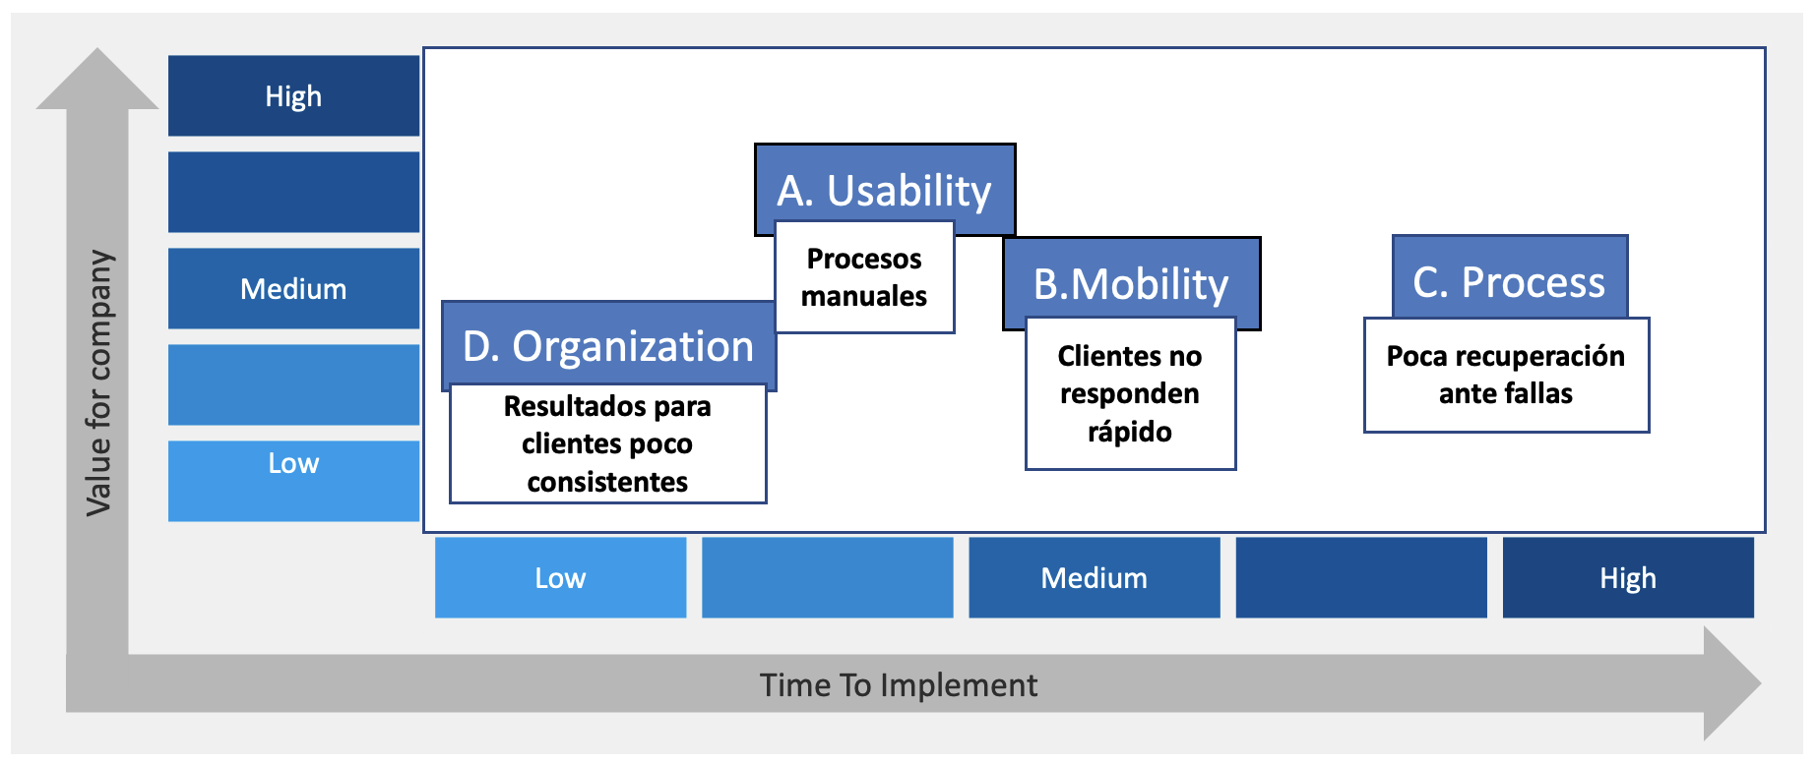
VALUE HEAT MAP

Slide 4
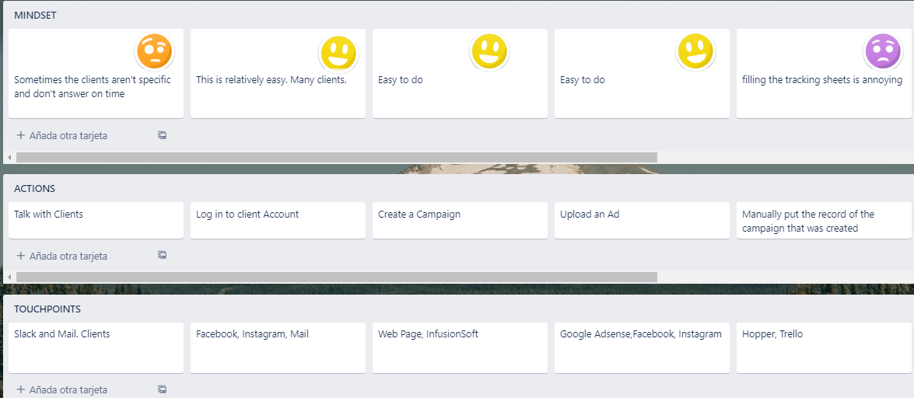
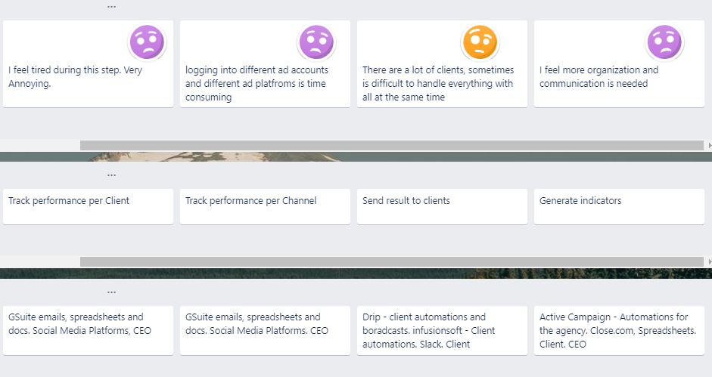
Ideal User Journey

Slide 5
The process of manually filling all the reports is a tedious task: There are many clients and for each of them we have to manually input, copy and paste al the data.
Main Pain Point

Slide 6
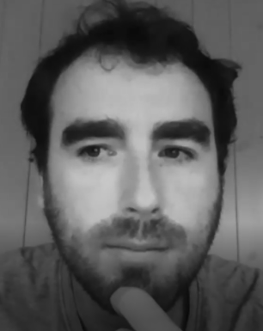
Final user: ciaran
Media buyer
IAG Marketing
In Charge Of:
E-mail distribution and Ads
Tracking metrics
Trace results

Slide 7
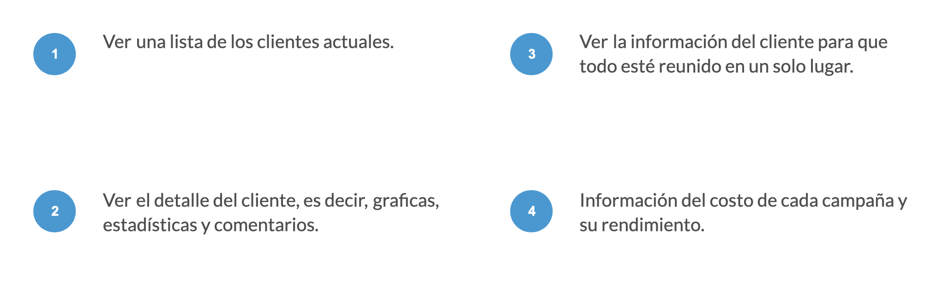
PROTOTYPE Functions
See a list of all the Clients
See all of the Client’s information in one place
See the details of a Client: Graphs and metrics
See Insights about the performance of each campaign

Slide 8
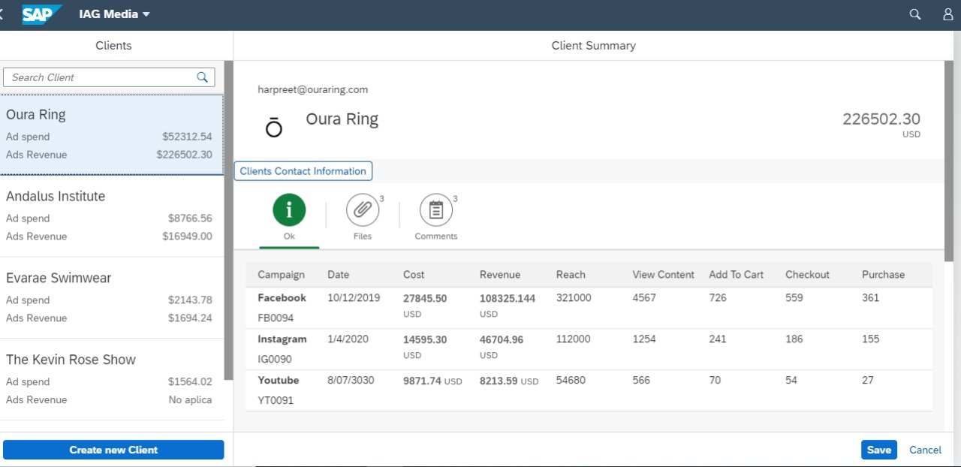
PrototYPE

Slide 9
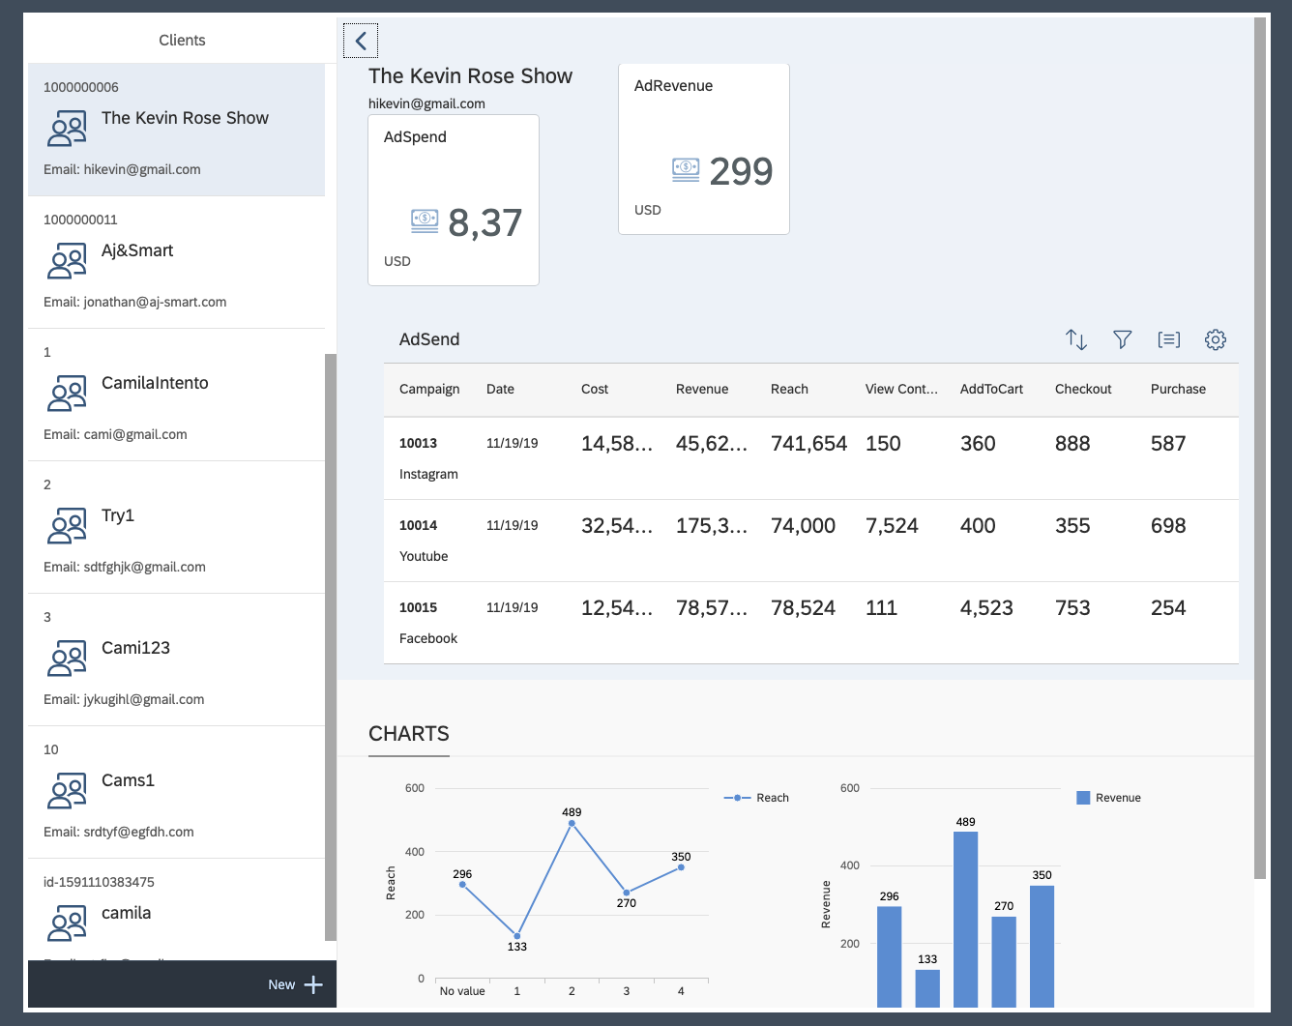
final APP

Slide 10
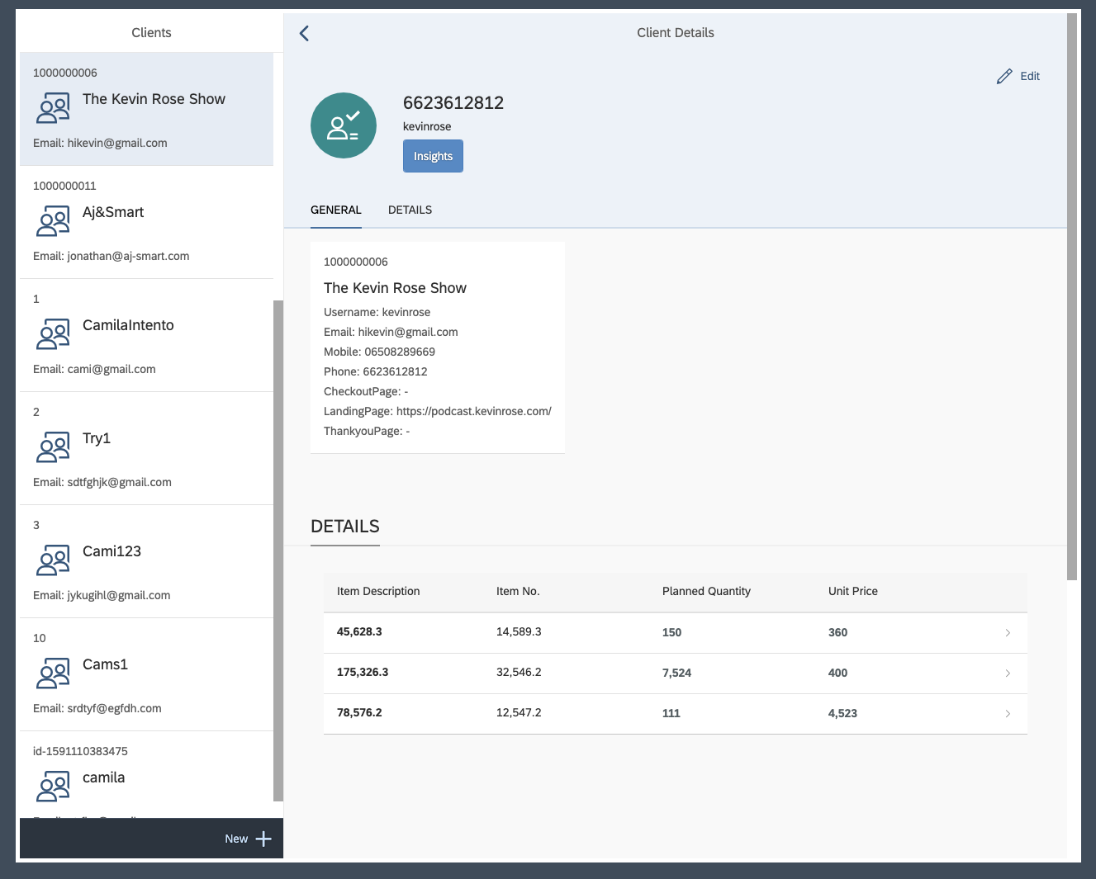
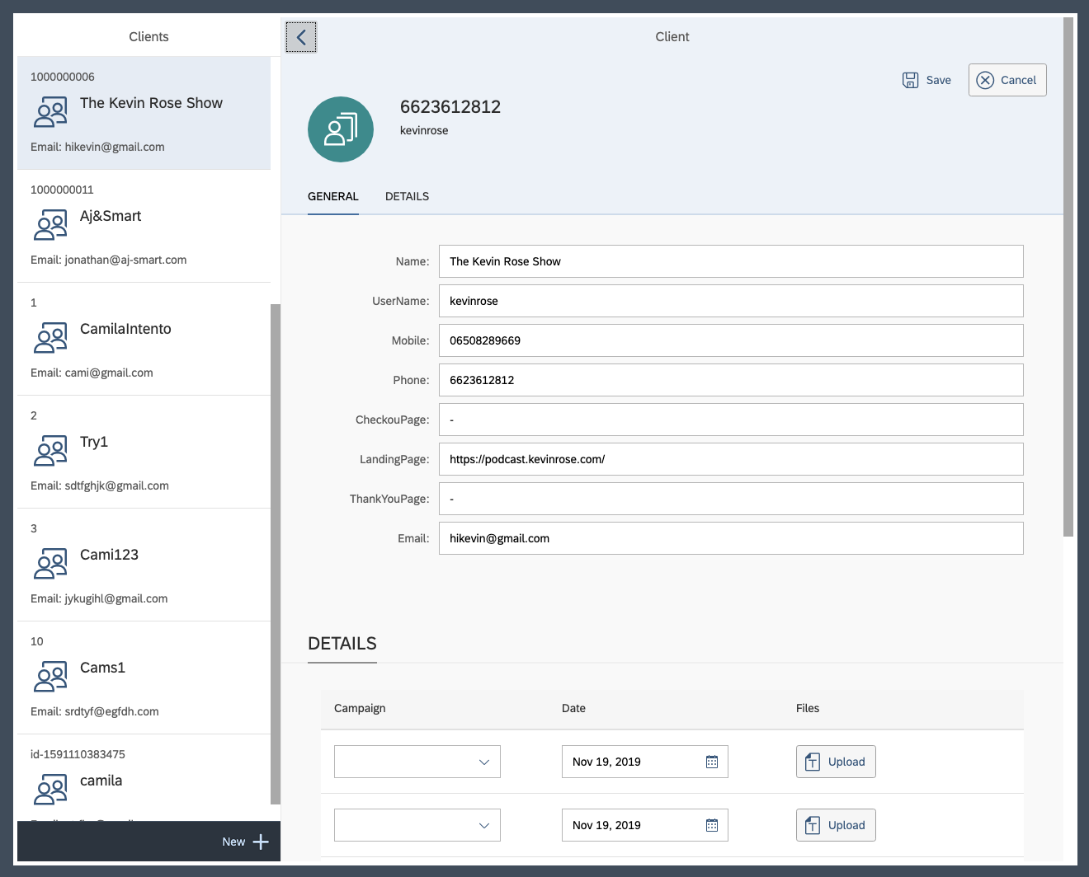
final APP

Slide 11
Final APP

Slide 12
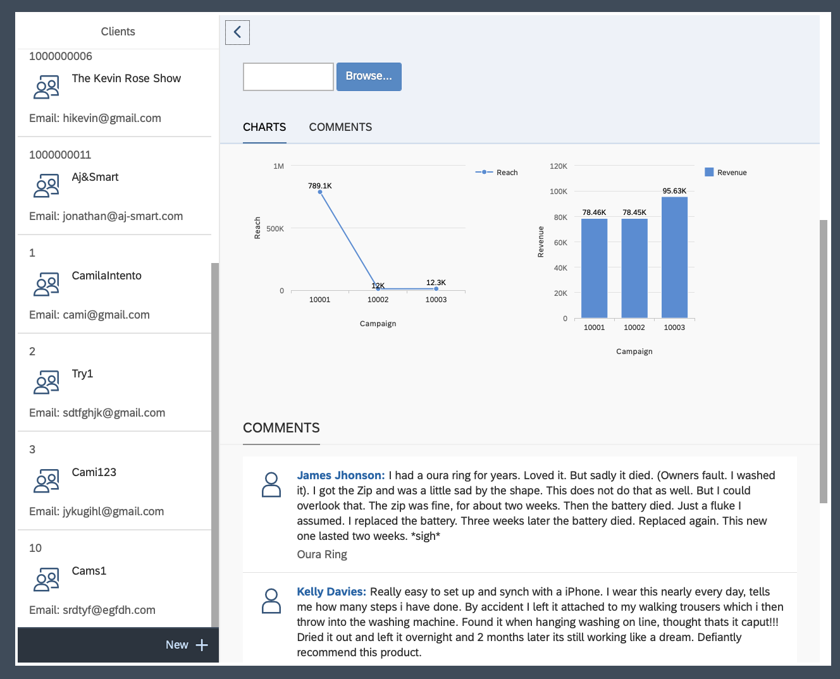
Final APP

Slide 13
THANK YOU
https://github.com/SISEMP-IAG-MEDIA/Project
Any Questions?

